Slide 1

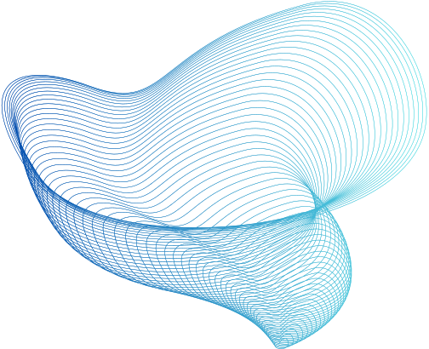

Group 2
Machine Learning
Rainfall Prediction

Slide 2

Objectives
To train the best model to predict whether it will rain the next day in Australia.

Slide 3
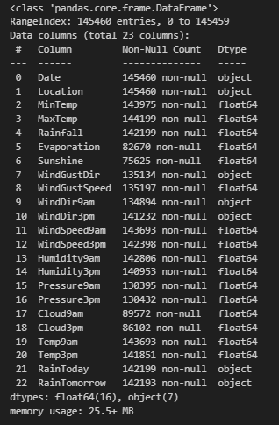
Dataset Description
Data Source
https://www.kaggle.com/datasets/jsphyg/weather-dataset-rattle-package/data
23 columns (variables)
145,460 (observations)
Data Mixture of Numeric, Categorical, Date

Slide 4
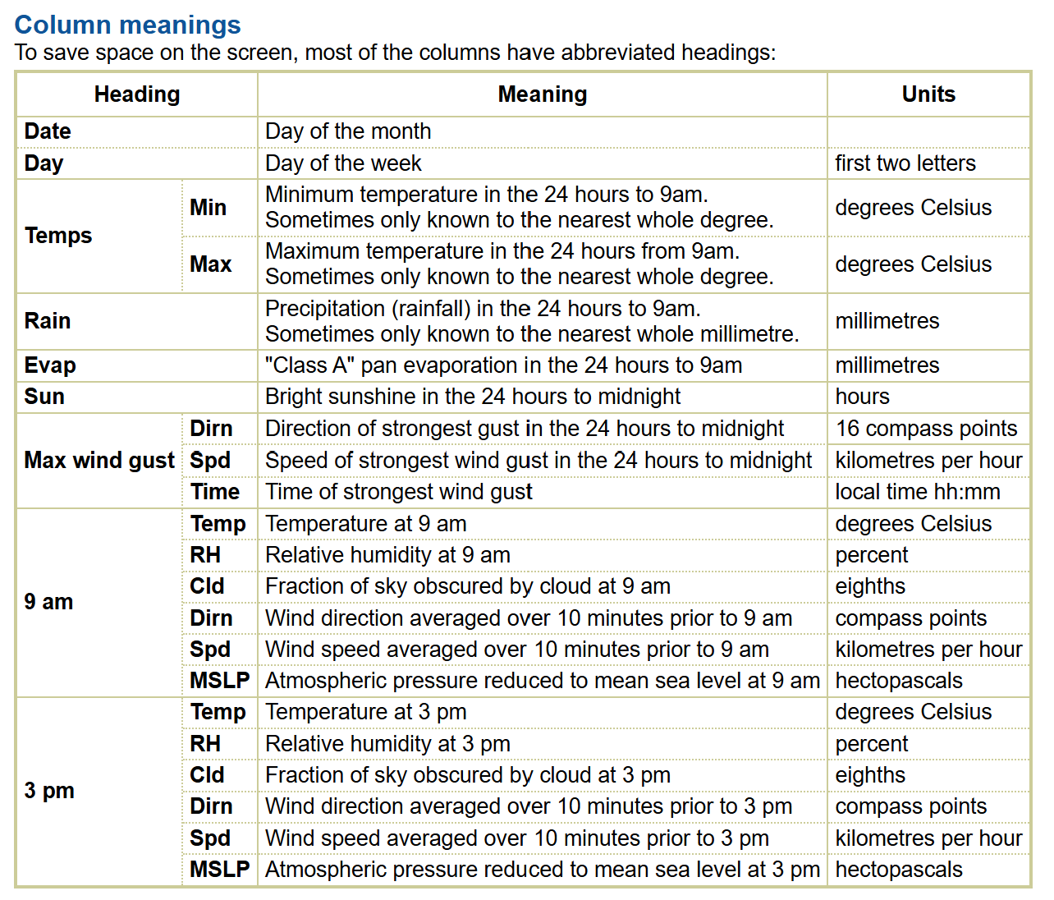
Dataset Description
Observations and Definitions are from
The Bureau of Meteorology (Australia)
10 years of daily weather observations from numerous Australian weather stations,
Bureau of Meteorology
from 1 Dec 2008 to 25 Jun 2017

Slide 5
Split Training, Testing Set
Training Set (81.74%)
Date before 2016-01-01
Testing Set (18.26%)
Date on or after 2016-01-01

Slide 6


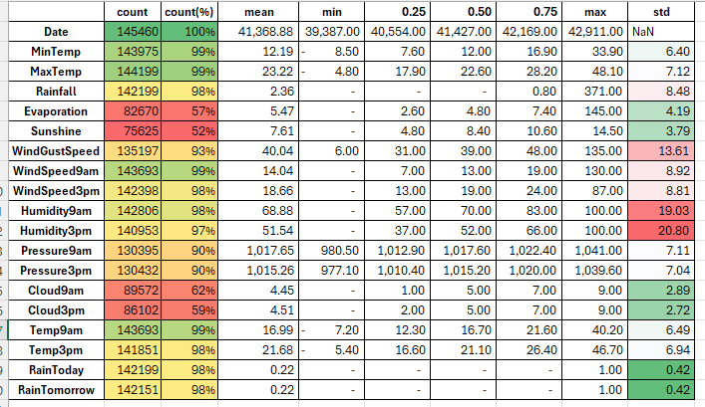
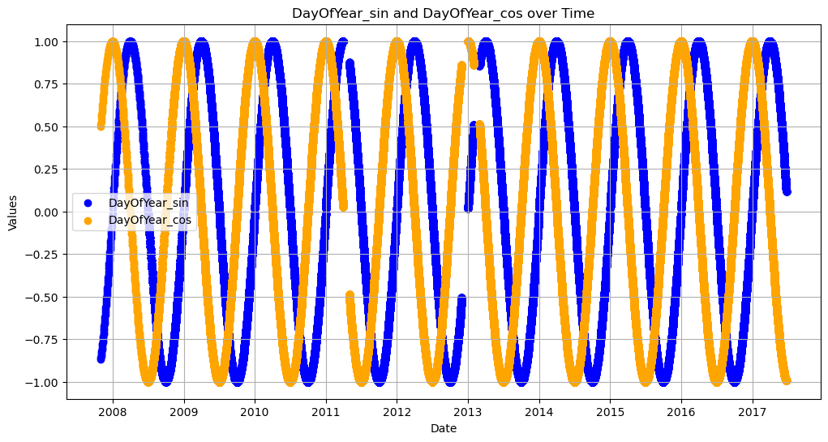
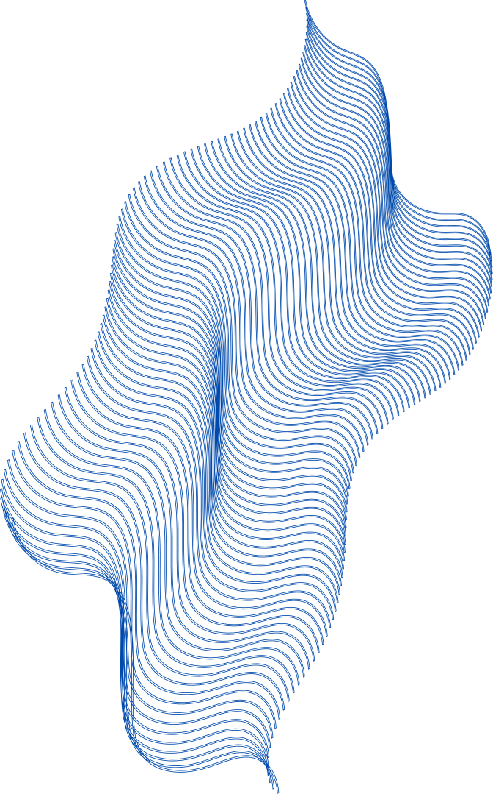
Pre-Processing
Missing Value
ffill: Fill NA/NaN values by propagating the last valid
observation to next valid.
Mode
Encoding
Date => Date of year => sin, cos
Location => Latitude, Longitude
(Logistic Regression Model: One-hot Encoding)
Direction => Degree => sin, cos
(Logistic Regression Model: One-hot Encoding)

Slide 7
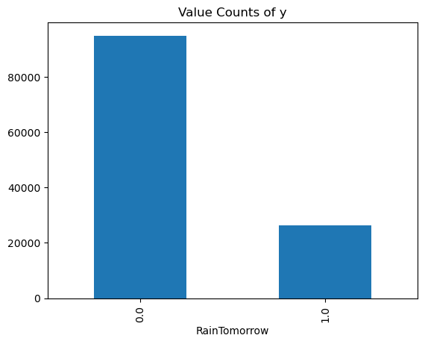
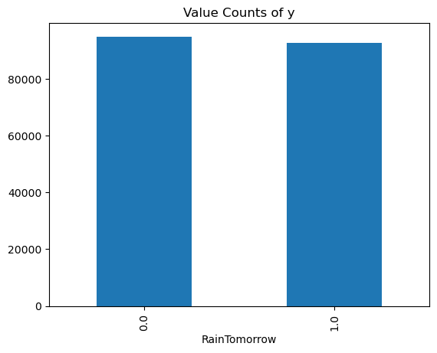
Re-sampling
Adaptive Synthetic Sampling (ADASYN)

Slide 8
Methodology
Machine Learning Approach
Supervised Learning
Model Selection & Hyperparameter Tuning by Grid Search
Model | Hyperparameter Tuned
Logistic Regression | Solver , Penalty
K Nearest Neighbor (KNN) | N neighbors , Metric
Decision Tree | Criterion , Maximum of Depth
Random Forest | Criterion , Maximum of Depth

Slide 9
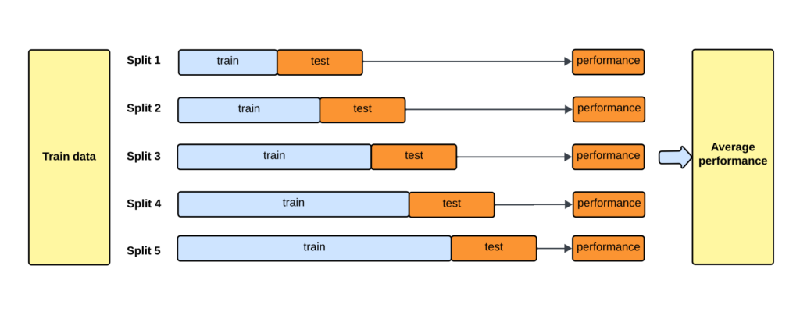
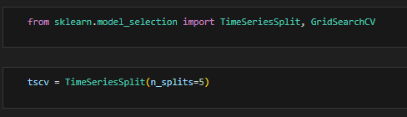
Methodology
Time Series Split Cross Validation for Grid Search
The first chunk of train data will never be included in the test set to avoid any potential data leakage.

Slide 10
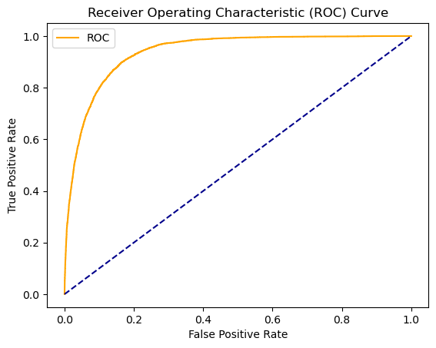
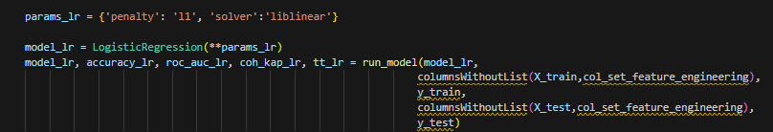
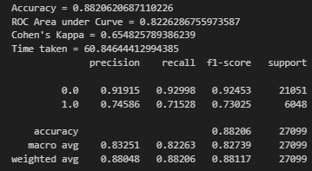
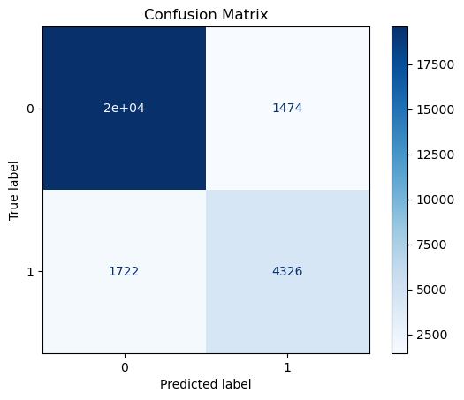
Analysis
(Before Grid Search)
Logistic Regression

Slide 11
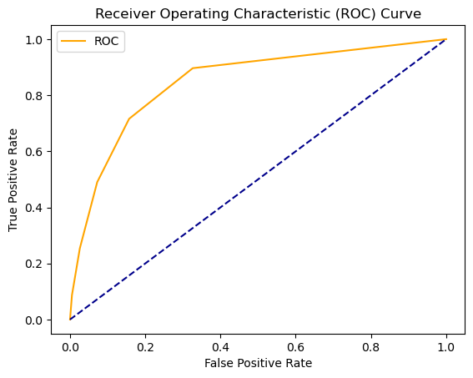
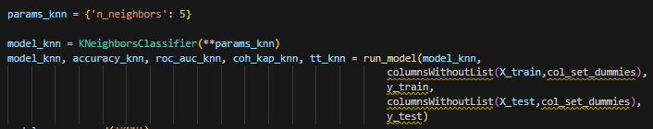
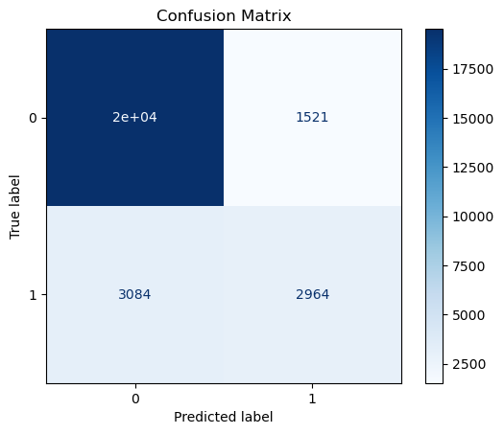
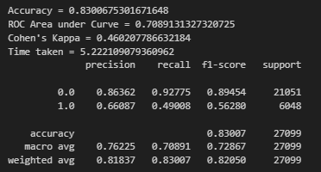
Analysis
(Before Grid Search)
K-nearest neighbor (KNN)

Slide 12
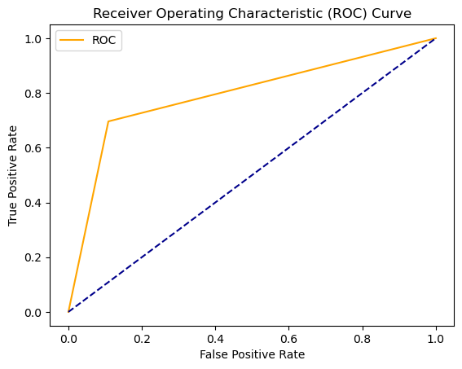
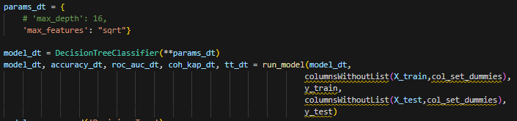

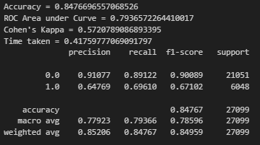
Analysis
(Before Grid Search)
Decision Tree

Slide 13
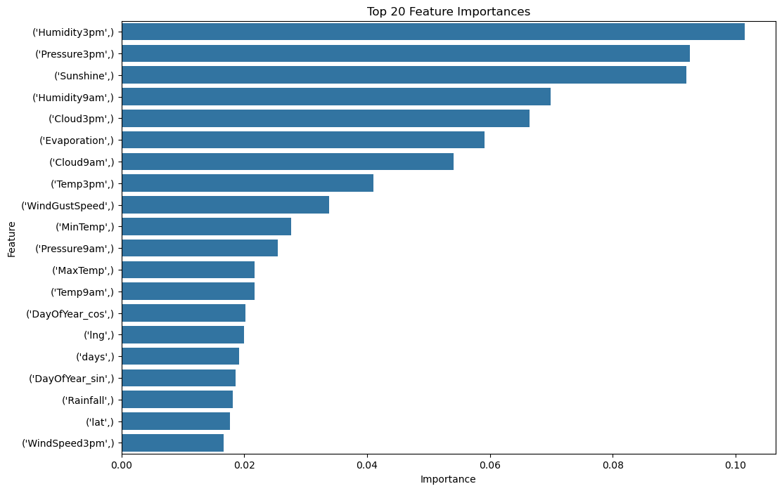
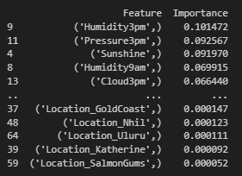
Analysis
(Before Grid Search)
Decision Tree

Slide 14
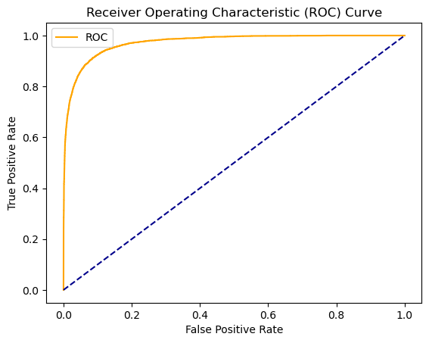
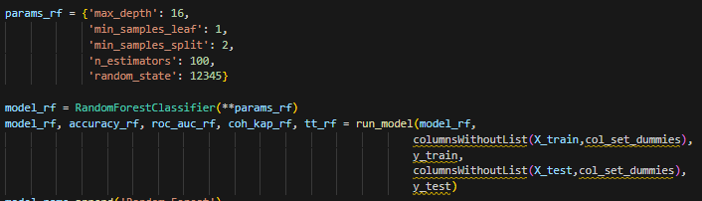

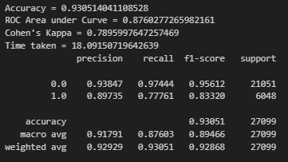
Analysis
(Before Grid Search)
Random Forest

Slide 15
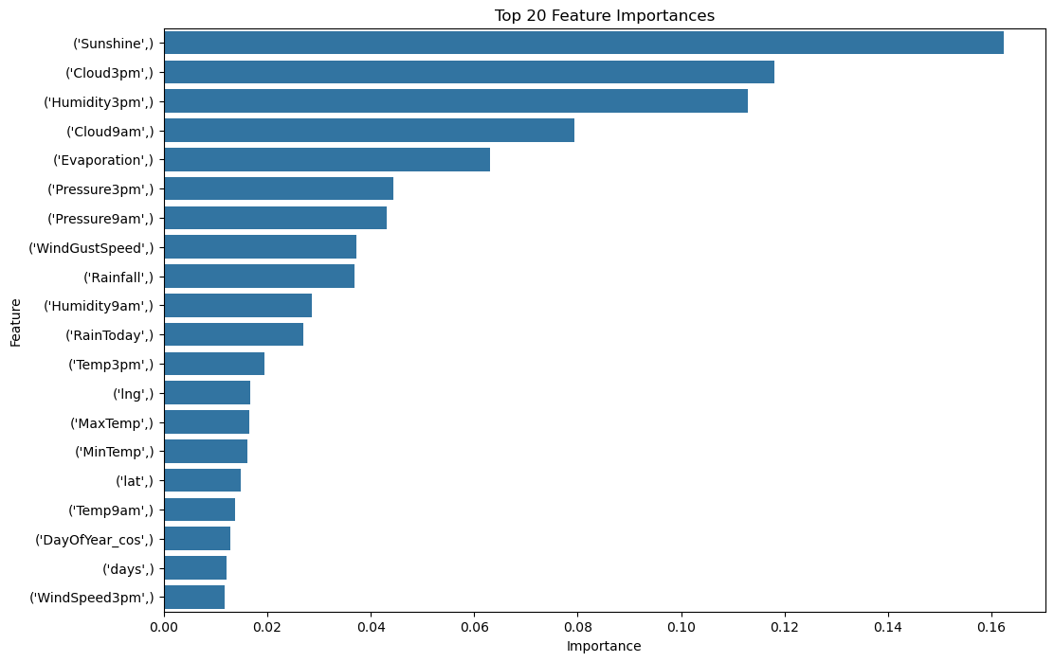
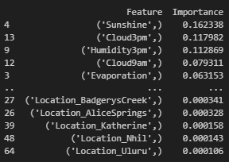
Analysis
(Before Grid Search)
Random Forest

Slide 16
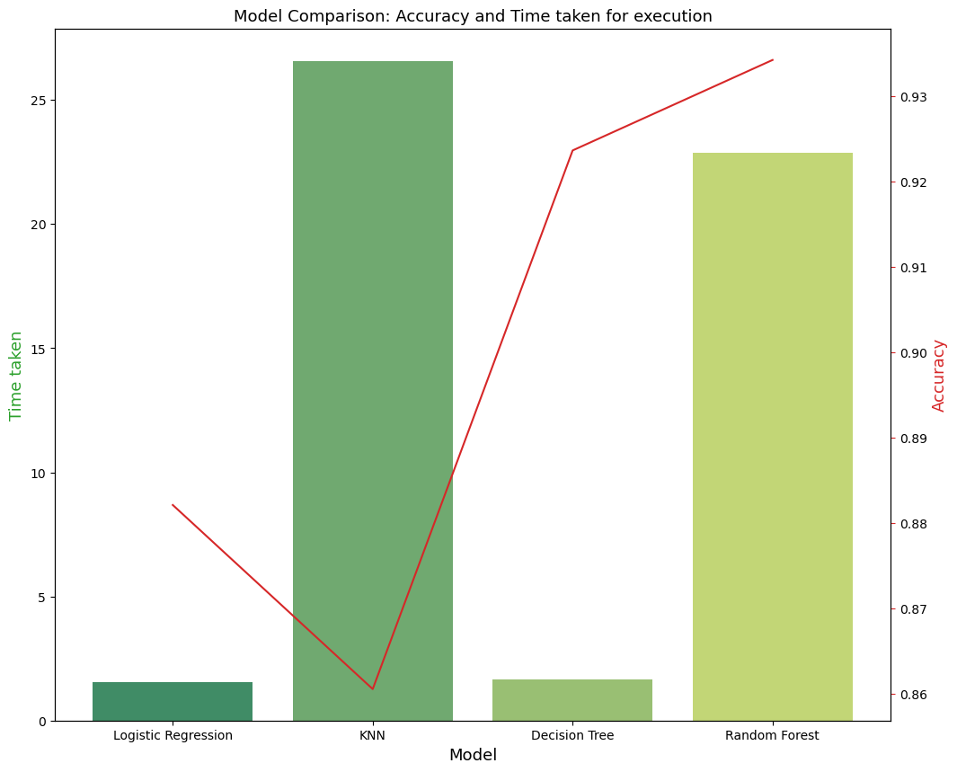
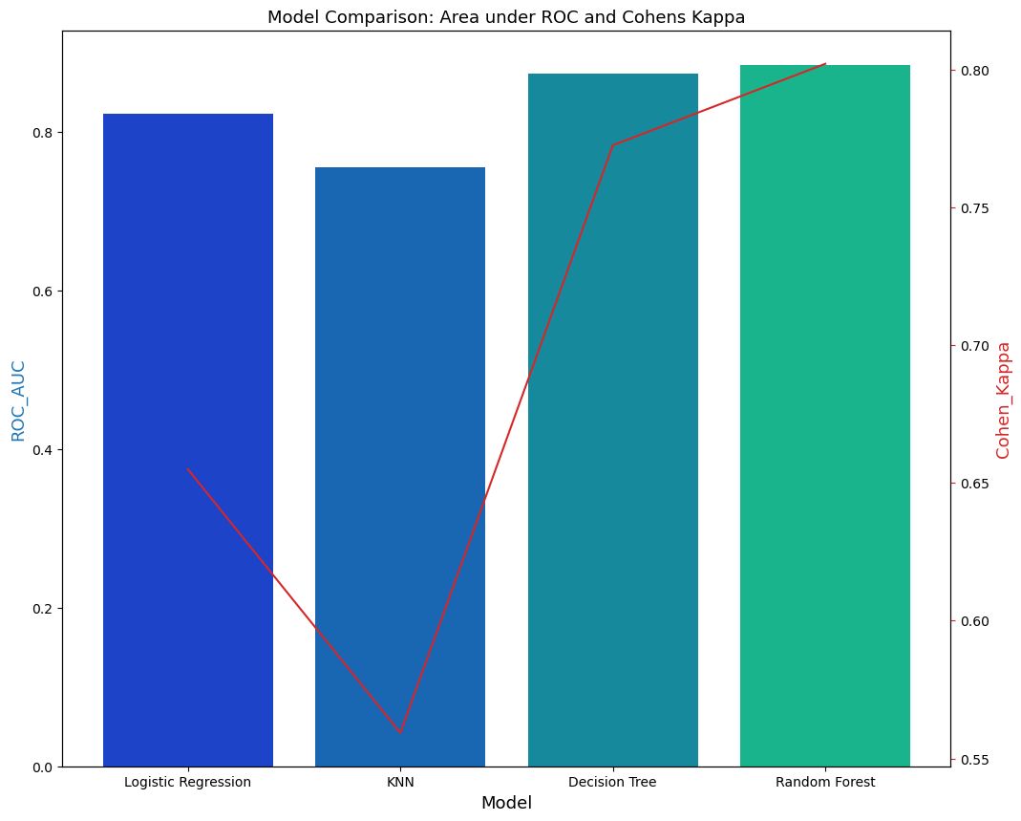
Analysis
(Before Grid Search) Model Comparison
Before Grid Search,
Random Forest has the highest accuracy among the four models trained.

Slide 17
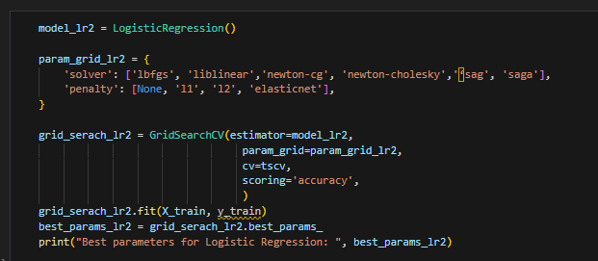
Analysis
(Grid Search)
Logistic Regression
Cross Validation | Time Series Split
Hyperparameter Tuned | Solver , Penalty

Slide 18

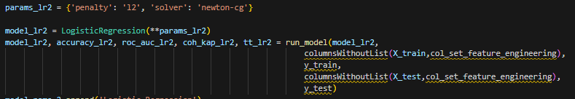
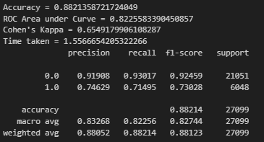

Analysis
(After Grid Search)
Logistic Regression

Slide 19
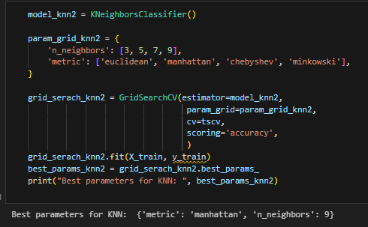
Analysis
(Grid Search)
KNN
Cross Validation | Time Series Split
Hyperparameter Tuned | N neighbors , Metric

Slide 20
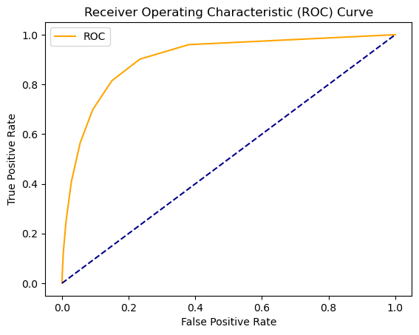
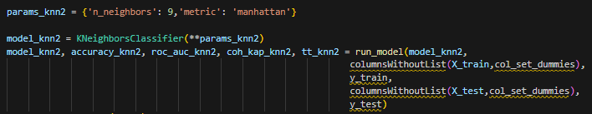
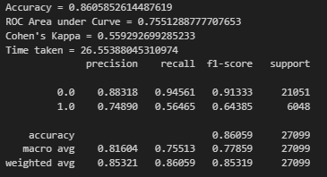

Analysis
(After Grid Search)
KNN

Slide 21
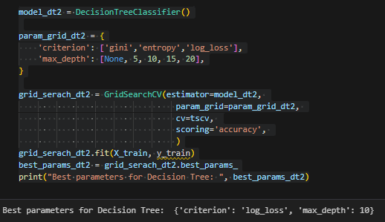
Analysis
(Grid Search)
Decision Tree
Cross Validation | Time Series Split
Hyperparameter Tuned | Criterion , Maximum of Depth

Slide 22
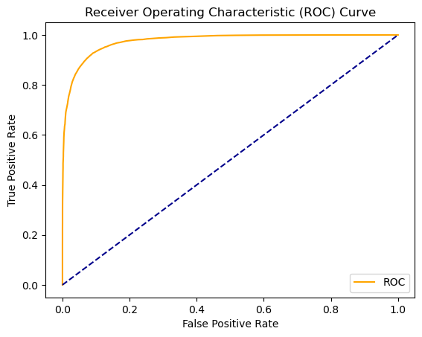
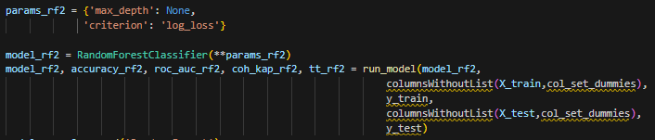

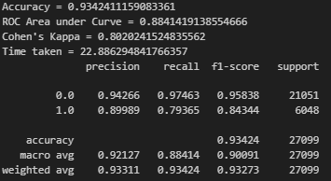
Analysis
(After Grid Search)
Decision Tree

Slide 23
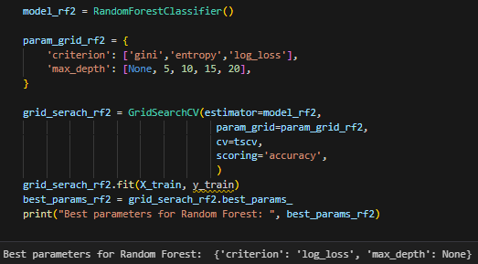
Analysis
(Grid Search)
Random Forest
Cross Validation | Time Series Split
Hyperparameter Tuned | Criterion , Maximum of Depth

Slide 24
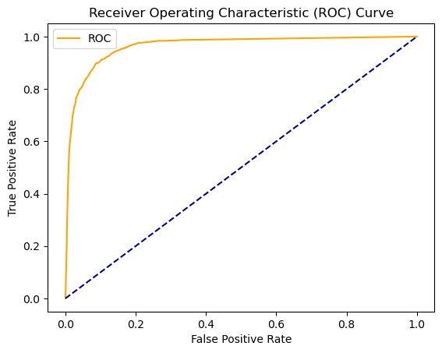
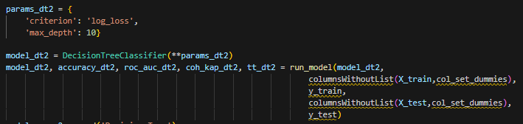

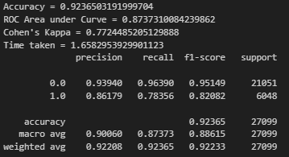
Analysis
(After Grid Search)
Random Forest

Slide 25
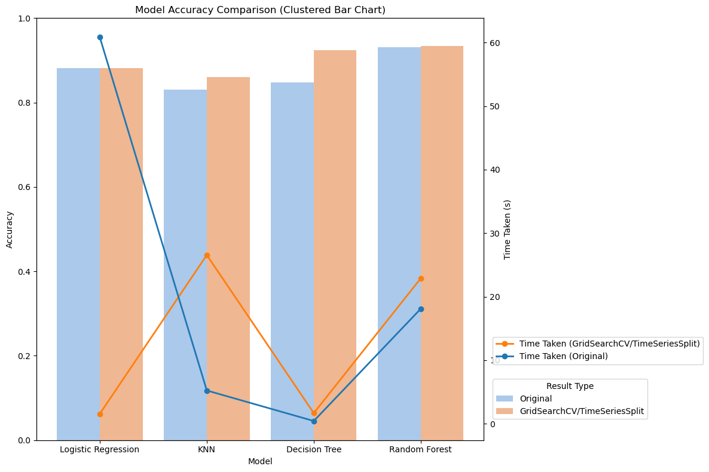
Analysis
(After Grid Search) Model Comparison
After Grid Search,
Random Forest still has the highest accuracy
among the four models trained.

Slide 26
Challenges & Limitations
Data Leakage
Class Imbalance
Other Factors
Train-Test Split by randomness is not appropriate
The most appropriate method for balancing class had to be found
The dataset might not include all factors that lead to rainfall

Slide 27
Future Work
Feature Selection ( currently limited by domain expertise)
Train more Models (currently limited by time and knowledge)
Incorporate more factors

Slide 28

Conclusion
Our team has successfully trained several models, one of which at best achieved 92.4% accuracy in the testing session.
Data + Model = Perfect Combo in worldwide universal application

Slide 29
Distribution of Works
All of us share even distribution of work in all the aspects!
Great Teamwork!

Slide 30
Q & A

